Slide 1
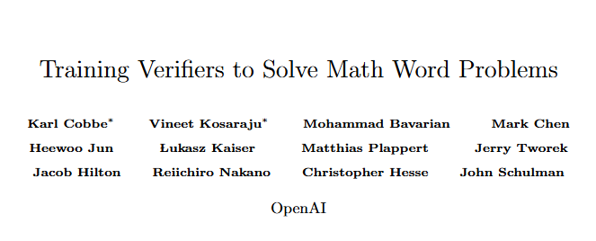
Published in 2021
Reward model & RLHF(reinforce learning human feedback)

Slide 2
Background:
benefits of increasing model size
falter when required to perform multi-step mathematical
Motivation:
no mechanism to correct their own errors -> We propose training verifiers to evaluate the correctness of model
To facilitate research -> we are releasing GSM8K
Contribution
We present a curated dataset of 8.5K grade school math questions and natural language solutions, useful for probing the informal reasoning ability of large language models.
We show that, compared to a finetuning baseline, the use of verifiers results in approximately the same performance boost as a 30x model size increase, and that verifiers scale significantly better with increased data.
We show that dropout acts as a strong regularizer, significantly improving performance for both finetuning and verification.

Slide 3
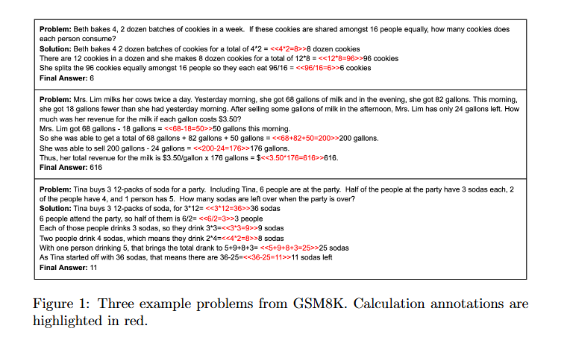
GSM8K
Description:
8.5K high quality grade school math problems created by human problem writers
between 2 and 8 steps to solve
basic arithmetic operations (+ − ×÷)
Train/Test: 7.5K /1K

Slide 4
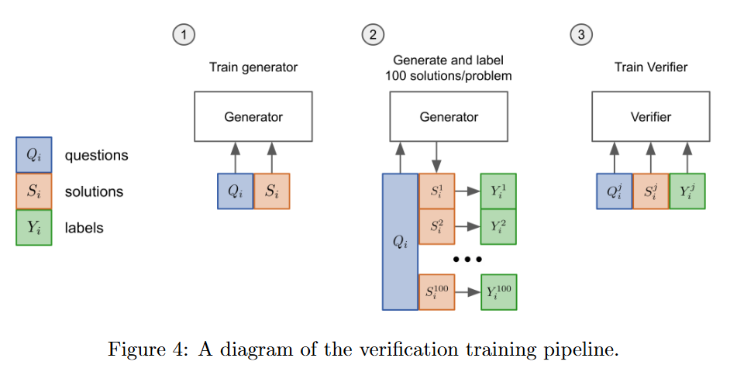
Method

Slide 5
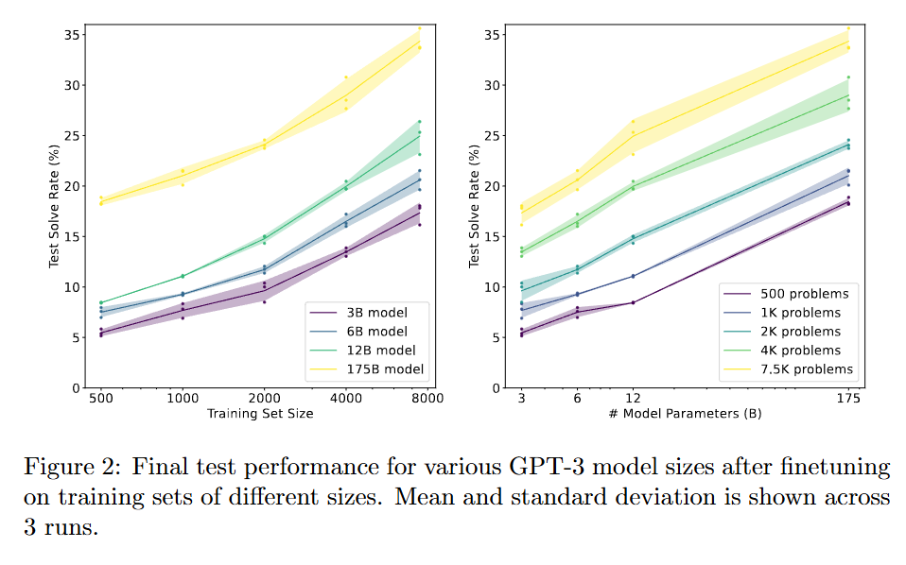
Finetuning
175B model significantly outperforms the smaller models -> a model with 10^16 parameters would be required to reach an 80% solve rate

Slide 6
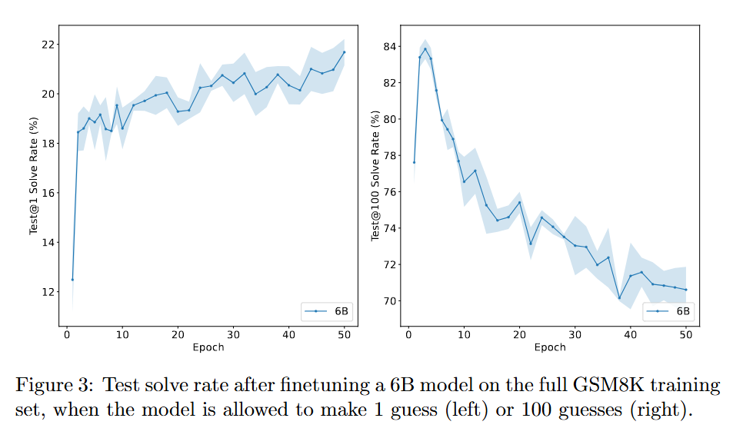
Finetuning
test@N to denote the percentage of problems solved correctly at least once when allowing the model to make N separate guesses foreach problem
Finetuning 会带来test @1 上升， test @100 下降： as the model repeatedly encounters the same data, it becomes increasingly uncalibrated and overconfident in its prediction
COT 结果会比直接生成答案效果好很多：it is important to allow the model to generate the full natural language solution before outputting a final answer. If we instead finetune a 6B model to directly output the final answer without any intermediate steps, performance drops drastically from 20.6% to 5.2%.

Slide 7
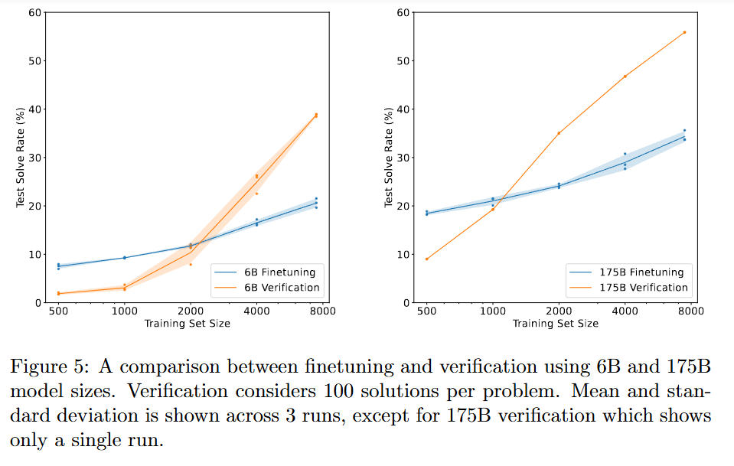
Verification
Finetune a model (the “generator”) for 2 epochs on the training set.
Sample 100 completions from the generator for each training problem and label each solution as correct or incorrect.
Train a verifier for a single epoch on this dataset.
Reward model scale 效率远大于生成模型效率

Slide 8
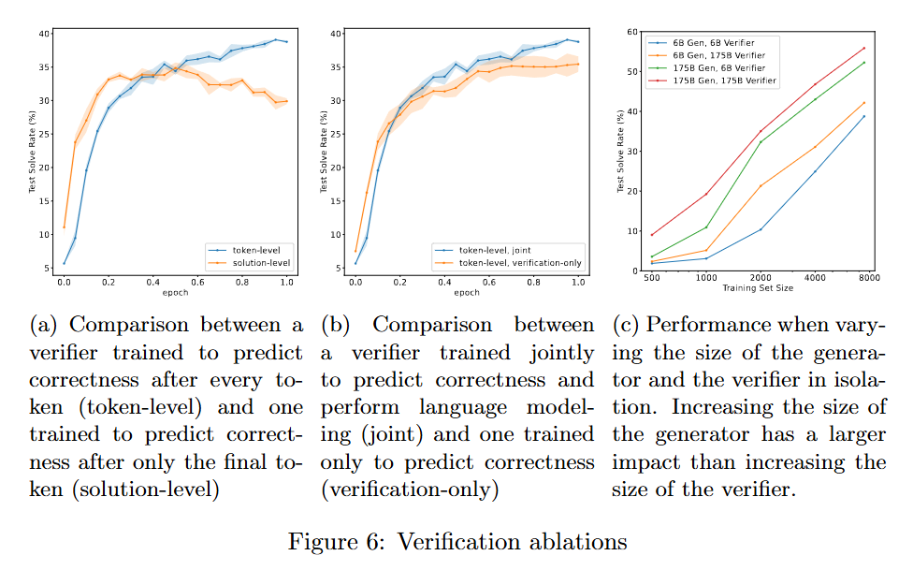
Verification
Token-level verifier 具有更好的效果
同时训练LM next token prediction task和 verify task效果会比较好
小的verifier 效果和大的verifier效果差不多了

Slide 9
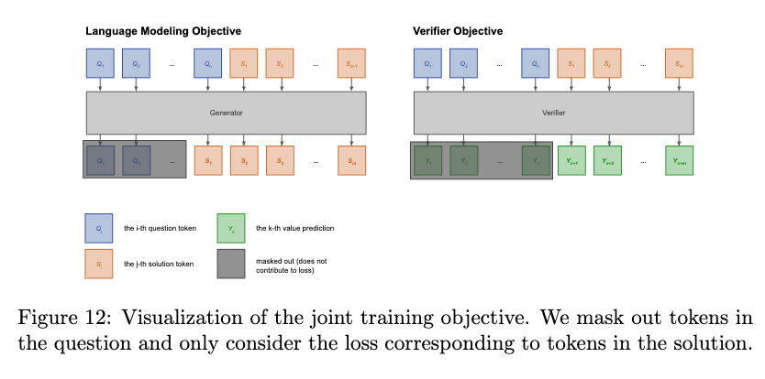

Slide 10
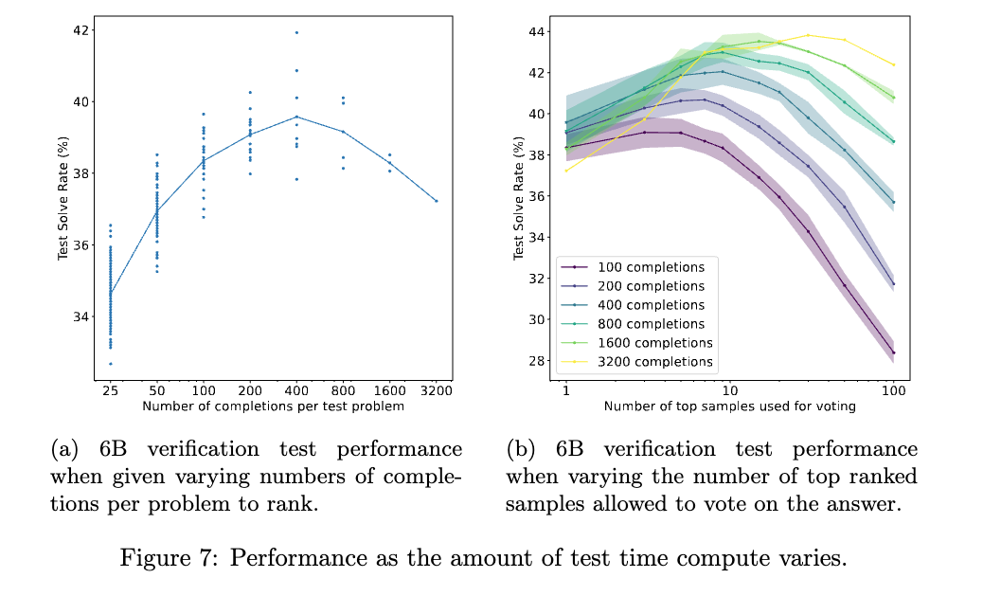
Verification
选择生成100个completion为verifier的候选，原因如下: At this scale, performance improves as we increase the number of completions up to 400. Beyond this point, performance start to decrease. This suggests that the benefits of search are eventually outweighed by the risk of finding adversarial solutions that fool the verifier. In general, we evaluate verifier test performance using 100 completions, since this captures most of the benefits of verification with a relatively modest compute cost. 1）过大的completion会生成对抗样本，让verifier出错。2）Test time时间太长了。
A: She has 3 apples. She gives away 2. So 3 - 2 = 1. Answer: 1
B: She has 3 apples. She eats 2. Now she has 2 left. Answer: 2
C: She has 3 apples. 3 - 2 = 1. She gives another one. Answer: 0

Slide 11
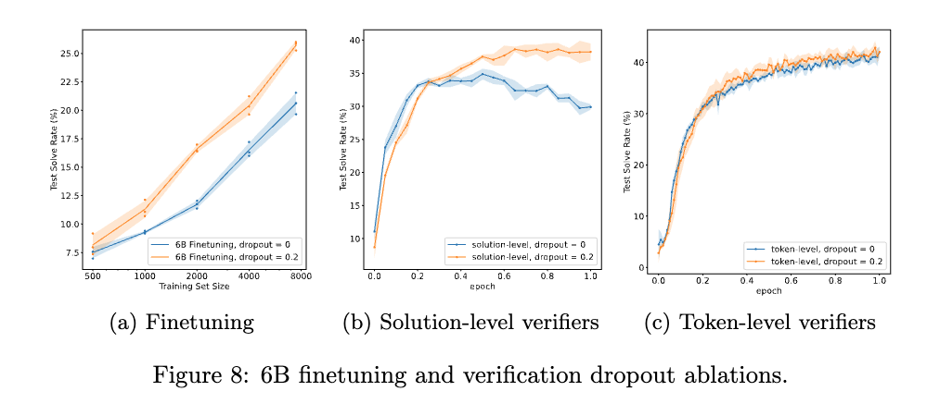
Dropout
Dropout的有效性：We find that both finetuning and verification strongly benefit from the use of dropout as a regularizer.

